Slide 1
Unit 3 [Browsing Linux FileSystem]
General Syntax of commands <Command Name> [option] <argument> Command Name → Represents the command to be executed Option → It modifies commands behavior Begins with '-' or '--' Argument → It can be filename / directory Name or other any parameter required by the command
Simply to see the current directory files Eg: $ls
To see the files under /etc folder
Eg: $ls /etc

Slide 2
To show long details listing Eg: $ls –l /etc
Running Multiple Commands on the Same Command-line
Syntax :
cmd1 <seprator> cmd2 <seprator> cmd3 .... & so on Eg: $clear;ls;date
$clear → To clear the screen $ls →Display current directory $date →Displays current date and time

Slide 4
Changing Date and Time
#date set=2013 --set=2012-08-21 (To change Date) date format: yyyy-mm-dd
#date --set=17:32:00 ( To change Time) time format: hh24:mi:ss
#date -> to confirm
To see current time zone #system-config-date
Notes:
ftp.kernal.org -→linux source code is downloaded
ftp.gnu.org
GPL [GNU public License]

Slide 5
To View Calender
$cal → Displays Current Months calender $cal 2012 → Displays whole years calender $cal -y (current year) $cal 1 1976 → Displays calender of the given month of the given year

Slide 6
Creating Files & Directories
Max char for file/dir name can be 255 char long.
File names are case-sensitive.
Files whose name begin with '.' are hidden.
Files whose name contains special character like space,>,<,?,* , etc need special protection.
Eg: $cat >.testfile
……….. (save)
$ls
Note: $ls -a → LIst both the normal & hidden files/dir $ls -la → details with hidden files $ls -d .* → Will display all with limited to directory only not sub directory $ls .* → Will display all

Slide 7
$cat > anup paudel → Will show error, special character, space will must be removed or special character within quote acceptable $cat > "anup Paudel" → ok $cat > ram\ shrestha text.... <enter> CTRL+d → Space will behave as string (kills the meaning of the next character) To View $cat ram\ shrestha $cat "nep*al" or $cat nep\*al

Slide 8
Color Codes
White → Normal text file Blue → Directory Cyan → Soft Link (shortcut folder) Yellow → Device files Red → Archived,compressed, or package file (.tar,.gz,.rpm,etc) Magenta → Picture file (.jpg, .bmp, .xpm,etc) Green → Executable file (.sh,.bash,.com,etc) Eg:
$ls /bin
$ls –l /bin → All executable file will be in green
$cat > f1.sh
$ls –l → Will not display as green. This is normal file. To make it executable and in green color
$chmod a+x f1.sh
$ls -l

Slide 9
To see yellow color files
$ls /dev
To see compressed file with red color
$ls /boot/grub
To see magenta color files (pink type)
$ls /var/www/icons

Slide 10
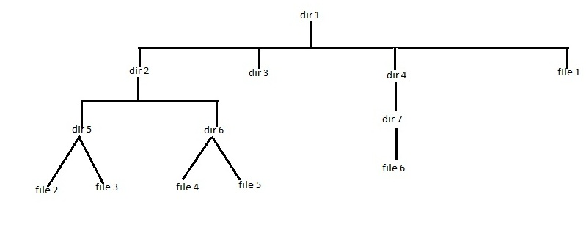

Slide 11
Renaming & Moving Files
Syntax:
mv [option] <source> <destination> -I → Prompts for confirmation before overwrite (Default for root) -f → Does not prompt for confirmation before overwrite (Default for normal user)
To rename file1 to f1
$mv file f1
To move f1 to other directory
current location : home/tashi/dir1
$mv f1 dir2/dir5 (relative path)
$mv f1 /home/tashi/dir1/dir2/dir5 (absolute path) $ls $ls dir2/dir5
Notes:
NOte : Same mv command will do both rename and move file
: If <Destination> is the name of a directory, move operation takes place : If <Destination> is not the name of the direcotory , then rename operation takes place.

Slide 12
To move and rename file at a time
$mv /home/tashi/dir1/dir2/dir5/f1 /home/tashi/dir1/file1
Now moving file1 to dir4/dir7/file6 and overwriting
$mv /home/tashi/dir1/file1 /home/tashi/dir1/dir4/dir7/file6
To confirm: $cd dir1 $vi dir4/dir7/file6
Now for confirmation for overlapping move and rename $mv -i dir2/dir6/file5 /home/anup/dir1/dir4/dir7/file6 ask question yes? y-> for yes n-> for no

Slide 13
Copying Files & Directory
Syntax
$cp [option] <Source> <Destination> -i, -f → Same meanings as 'mv' -r → To copy a directory and its contents / sub-contents
To copy file3 of dir5 to dir3
$cp file3 ../../dir3
To copy file3 to dir7 with rename file2 $cp file3 /home/tashi/dir1/dir4/dir7/file2
To copy directory dir5 to directory dir4 $cp -r /home/tashi/dir1/dir2/dir5 /home/tashi/dir1/dir4
To Confirm
$ls –R dir1

Slide 14
Removing Files & Directories
Syntax:
$rm [optoin] <File/Dir> -i → Prompts for confirmation before removal {Default for r root} -f → Does not prompt for confirmation before removal { Default for normal users} -r → To remove a directory Eg:
$rm file1 →Not prompt
#rm file1 → prompt

Slide 15
Linux File System Structure
/ → Top of the file filesystem [called root directory) /boot -> Contains Kernel as well as files required for booting /root -> Administrators' home directory /home -> Contains normal users home directories /usr -> Contains libraries, binaries, documentation, etc /bin , /usr/bin -> Contains non-administrative commands /sbin , /usr/sbin -> Contians administrative commands /etc -> contains configuration files /dev -> contains device files /lib -> contains 32-bit shared libraries /lib64 -> Contains 64-bit shared libraries /mnt , /media, /misc -> Used as typical mount points /opt -> Contains third-party softwares /proc -> Contains system information /selinux -> contains SELinux related files /tmp -> Contains temporary files /var -> Contains web, mail, mail, log, etc files /lost+found -> It contains files found during system recovery process
Notes:
/ → Top of the file filesystem [called root directory)
<system directories created automatically at the time of OS installation)

Slide 16
Changing Directories
Two Methods
Absolute Path Method
Relative Path Method => Uses '.' & '..' To change directories .. → represents parent directory . →represents current directory
$pwd
$cd <enter> → Will move to user home directory
Relative Path
$cd dir1/dir4/dir7
To move the location to dir5
$cd ../ ../dir2/dir5
Now creating file7 from dir5 to dir6
$cat > ../dir6/file7

Slide 17
Using Wildcard Characters
Wildcard Characters | Meanings --------------------------------------------------------------------------- ? Matches any Single Chars
. Matches any Number of char
[a-z] Matches within the range
[^a-z] Matches out of the range
[az] Matches within the set
[^az] Matches out of the set

Slide 18
Example
$cd /
$ls
$ls –d ???
$ls –d b?? [o/p bin]
$ls –d b* [o/p bin boot]
$ls –d *[m-z]
$ls –d [a-h]*
$ls –d [^a-h]*
$ls –d [m|h]*
$ls –d [^m|h]*
Notes:
Now create backup directory in home directory $cd <enter> $mkdir backup to copy all files starting with .conf to bakcup directory $cd / $cp etc/*.conf /home/anup/backup Now create directory limited_backup in directory dir7 $mkdir dir1/dir4/dir7/limited_backup Now to move backup files started with a-h to directory limited_backup $cd <enter> $cp backup/[a-h]* dir1/dir4/dir7/limited_backup To delete all other files from backup folder not ending with .conf string $ rm -i backup/ ???

Slide 19
THE END

